Slide 1
Midterm Exam
Lecturer: Ngo Huy Bien
Software Engineering Department
Faculty of Information Technology
VNUHCM - University of Science
Ho Chi Minh City, Vietnam
nhbien@fit.hcmus.edu.vn

Slide 2

Objectives

Slide 3

Contents

Slide 4

References

Slide 5

Workflow Demonstration
Demo of a problem solved by the built system.

Slide 6


Kanban Demonstration
Using the information from the Kanban board, demonstrate the process of creating the system up to the present.

Slide 7

Estimation Demonstration

Slide 8

Build and Integration Demonstration
Demo the build and source code integration among members.

Slide 9

Product Backlog Demonstration
Why are these stories included in the Product Backlog?

Slide 10
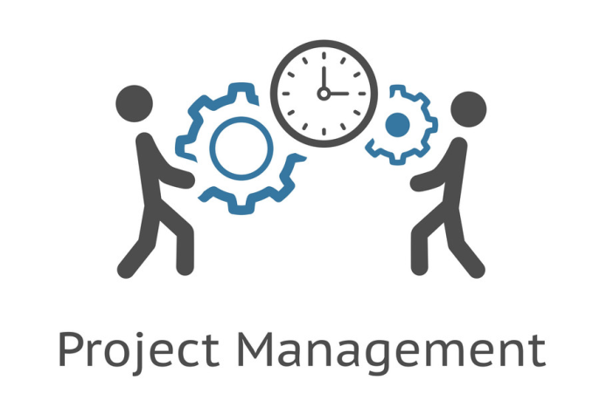
Estimation and Plan Demonstration
When will the entire Product Backlog be completed?

Slide 11
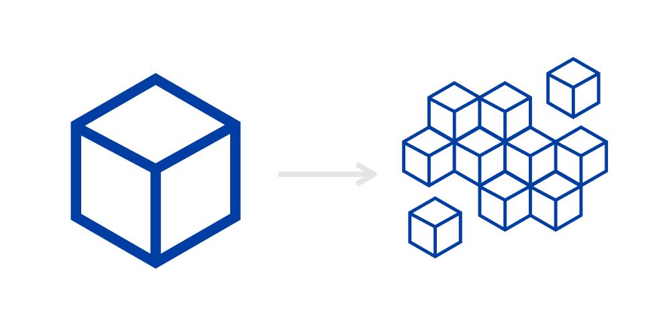
System Architecture Demonstration
Explain the development view of the architecture through the directory system and the build of all system components.
Explain logical view, process view of architecture through source code of a completed story.
Explain the deployment view of the architecture through the deployed system.

Slide 12

Thank You & See You Again

